Slide 1
INTRODUCTION TO ELECTRONICS (GTGE 121)
DR. SAMUEL AFOAKWA

Slide 2
Objective
This course will prepare the student on how to recognize and use basic electronics components, and will also cover the use of test equipment, including the oscilloscope, signal generator and multi-meter.

Slide 3
Contents
The content will cover these areas: Autonomous systems, The sensing–logic–actuation cycle in practice, Basic theory of electrical circuits, Basic electrical quantities, Relationships between quantities, Ohm’s law and Kirchhoff ’s laws, Series and parallel networks (combining the laws), Colour coding and standard resistor values, Voltage dividers
Designing a sensor circuit, Signals and signal processing, High-fidelity sound reproduction and electronics, Signals and sine waves, Making signals from combinations of sine waves, The square wave challenge.

Slide 4
Reading Materials
The Art of Electronics (Hardcover) by Paul Horowitz, Winfield Hill (1989): Cambridge University Press: ISBN 978-0-521-37095
Practical Electronics for Inventors: Paul Scherz: McGraw Hill (2000): ISBN-13: 978-0070580787
The Basic Soldering Guide Handbook: Learn to solder electronics successfully Paperback: Alan Winstanley – July 15, 2014: ISBN-13: 978-1500531140.

Slide 5
Basic Elements of Electronics
At the top of a chart of learning about electronics comes the theory
This involves learning about voltage, current, resistance, capacitance, inductance, and various laws and theorems that help predict the size and direction of voltages and currents within circuits.
As you learn the basic theory, you will be introduced to basic passive components such as resistors, capacitors, inductors, and transformers.

Slide 6
Next down the line are discrete passive circuits
Discrete passive circuits include current-limiting networks, voltage dividers, filter circuits, attenuators, and so on.
These simple circuits, by themselves, are not very interesting, but they are vital ingredients in more complex circuits.
After you have learned about passive components and circuits, you move on to discrete active devices, which are built from semiconductor materials

Slide 7
These devices consist mainly of diodes (one-way current-flow gates) and transistors (electrically controlled switches/amplifiers)
Once you have covered the discrete active devices, you get to discrete active/passive circuits.
Some of these circuits include rectifiers (ac-to-dc converters), amplifiers, oscillators, modulators, mixers, and voltage regulators.
Throughout your study of electronics, you will learn about various input/output (I/O) devices (transducers)

Slide 8
Input devices (sensors) convert physical signals, such as sound, light, and pressure, into electrical signals that circuits can use
These devices include microphones, phototransistors, switches, keyboards, thermistors, strain gauges, generators, and antennas.
Output devices convert electrical signals into physical signals
Output devices include lamps, LED and LCD displays, speakers, buzzers, motors (dc, servo, and stepper), solenoids, and antennas.
These I/O devices allow humans and circuits to communicate with one another.

Slide 9

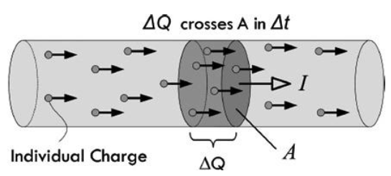
Electric Current
Electric current is the total charge that passes through some cross-sectional area A per unit time
This cross-sectional area could represent a disk placed in a gas, plasma, or liquid, but in electronics, this cross-sectional area is most frequently a slice through a solid material, such as a conductor
If ΔQ is the amount of charge passing through an area in a time interval Δt, then the average current I _{ave} is defined as:

Slide 10


The unit of current is coulombs per second, but this unit is also called the ampere (A), named after Andre-Marie Ampere:
Because the ampere is a rather large unit, current is also expressed in milliamps (1 mA = 1 × 10⁻³ A), microamps (1 μA = 1 × 10⁻⁶ A), and nanoamps (1 nA = 1 × 10⁻⁹ A)
Within conductors such as copper, electrical current is made up of free electrons moving through a lattice of copper ions. Copper has one free electron per copper atom
The charge on a single electron is given by:
This is equal to, but opposite in sign of, the charge of a single copper ion.

Slide 11


The positive charge is a result of the atom donating one electron to the “sea” of free electrons randomly moving about the lattice. The loss of the electron means there is one more proton per atom than electrons.
The charge of a proton is:
The conductor, as a whole, is neutral, since there are equal numbers of electrons and protons
We see that if a current of 1 A flows through a copper wire, the number of electrons flowing by a cross section of the wire in 1 s is equal to:
The negative sign indicate electrons flowing in the opposite direction as the defined current flow

Slide 12
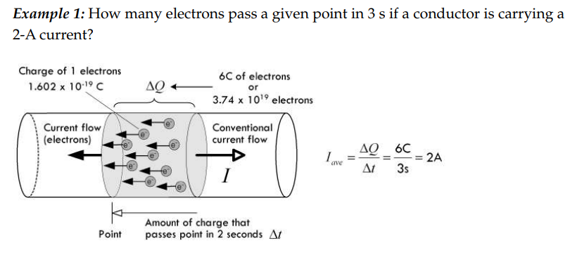
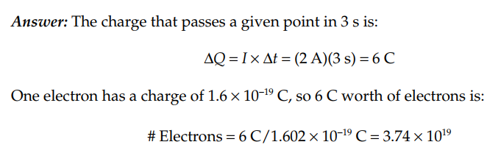

Slide 13
Currents in Perspective
What’s considered a lot or a little amount of current?
It’s a good idea to have a gauge of comparison when you start tinkering with electronic devices
Here are some examples: a 100-W light bulb draws about 1 A
A microwave draws 8 to 13 A; a laptop computer, 2 to 3 A; an electric fan, 1 A
A television, 1 to 3 A; a toaster, 7 to 10 A; a fluorescent light, 1 to 2 A; a radio/stereo, 1 to 4 A

Slide 14
A typical LED, 20 mA; a mobile (smart) phone accessing the web uses around 200 mA
An advanced low-power microchip (individual), a few µA to perhaps even several pA; an automobile starter, around 200 A
A lightning strike, around 1000 A; a sufficient amount of current to induce cardiac/respiratory arrest, around 100 mA to 1 A.

Slide 15
Voltage
To get electrical current to flow from one point to another, a voltage must exist between the two points.
A voltage placed across a conductor gives rise to an electromotive force (EMF) that is responsible for giving all free electrons within the conductor a push.
Voltage is also referred to as a potential difference or just potential
A simple flashlight circuit, consisting of a battery connected to a lamp, through two conductors and a switch, is shown in Fig. 2.4.

Slide 16
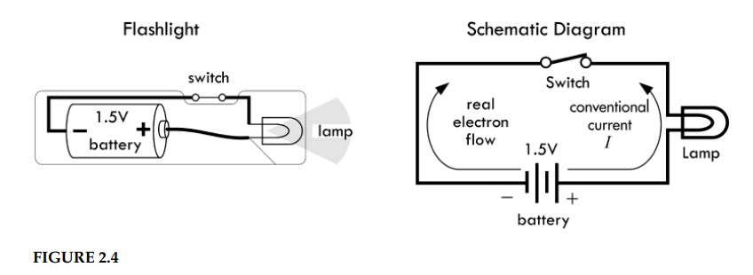

Slide 17
When the switch is open (“off”), no current will flow.
The moment the switch is closed, however, the resistance of the switch falls to almost zero, and current will flow
This voltage then drives all free electrons, everywhere within the circuit, in a direction that points from negative to positive; conventional current flow, of course, points in the opposite direction

Slide 18

Definition of Volt and Generalized Power Law
We come now to a formal definition of the volt—the unit of measure of voltage.
Using the relationship between voltage and potential energy difference
V = U/q, we define a volt to be:

Slide 19
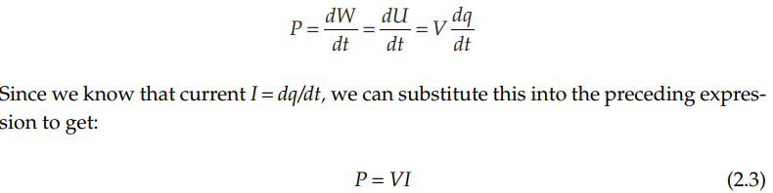
Another way to define a volt is in terms of power, which happens to be more useful in electronics.
Power represents how much energy per second goes into powering a circuit.
According to the conservation of energy, we can say the power used to drive a circuit must equal the power used by the circuit to do useful work plus the power wasted, as in the case of heat
By definition, power is mathematically expressed as dW/dt.
If we substitute the potential energy expression U = Vq for W, assuming the voltage is constant (e.g., battery voltage), we get the following:

Slide 20

This is referred to as the generalized power law
This law is incredibly powerful, and it provides a general result, one that is independent of type of material and of the nature of the charge movement
The unit of this electrical power is watts (W), with 1 W = 1 J/s, or in terms of volts and amps, 1 W = 1 VA
In terms of power, then, the volt is defined as:

Slide 21
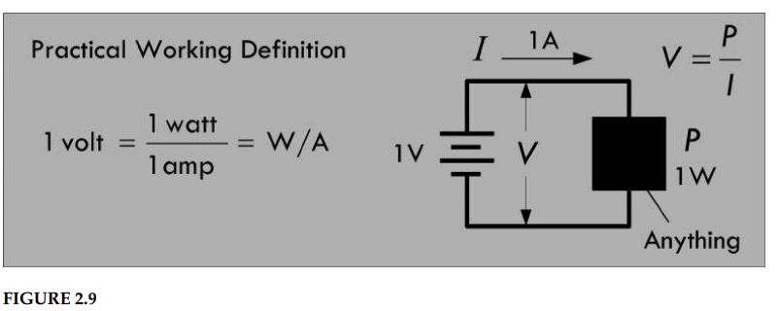
The generalized power law can be used to determine the power loss of any circuit, given only the voltage applied across it and the current drawn, both of which can easily be measured using a voltmeter and an ammeter.
However, it doesn’t tell you specifically how this power is used up—more on this when we get to resistance. See Fig. 2.9

Slide 22
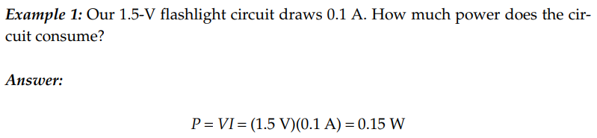
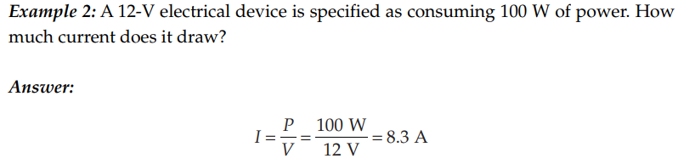

Slide 23
Resistance, Resistivity, Conductivity
Free electrons in a copper wire at room temperature undergo frequent collisions with other electrons, lattice ions, and impurities within the lattice that limit their forward motion
We associate these microscopic mechanisms that impede electron flow with electrical resistance
In 1826, George Simon Ohm published experimental results regarding the resistance of different materials, using a qualitative approach that wasn’t concerned with the hidden mechanisms, but rather considered only the net observable effects

Slide 24

He found a linear relationship between how much current flowed through a material when a given voltage was applied across it
He defined the resistance to be the ratio of the applied voltage divided by the resultant current flow, given by:

Slide 25
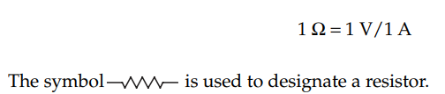
This statement is called Ohm’s law, where R is the resistance, given in volts per ampere or ohms (abbreviated with the Greek symbol omega, Ω)
One ohm is the resistance through which a current of 1 A flows when a voltage of 1 V is applied:
Now, Ohm’s law isn’t really a law, but rather an empirical statement about the behavior of materials. In fact, there are some materials for which Ohm’s law actually doesn’t work.

Slide 26
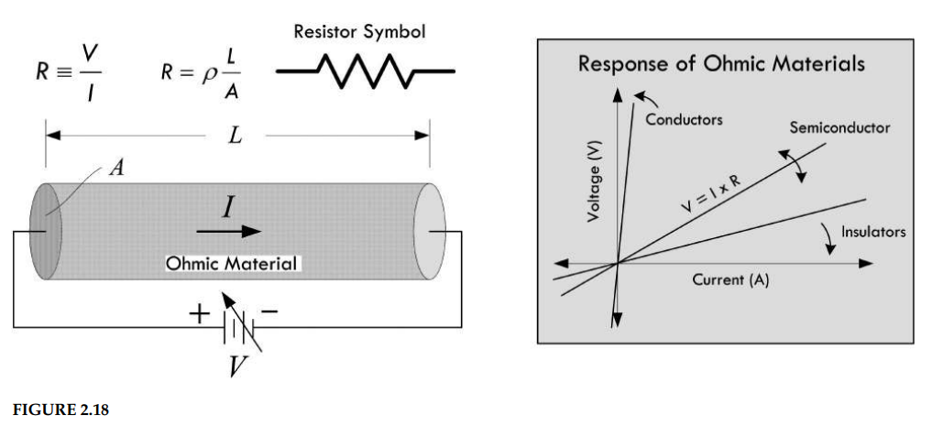

Slide 27
Ohm’s law can be applied only to ohmic materials—materials whose resistance remains constant over a range of voltages.
Nonohmic materials, on the other hand, do not follow this pattern; they do not obey Ohm’s law.
For example, a diode is a device that allows current to pass easily when the voltage is positive, but prevents current flow (creates a high resistance) when the voltage is negative.

Slide 28
How the Shape of a Conductor Affects Resistance
The resistance of a conducting wire of a given material varies with its shape
Doubling the length of a wire doubles the resistance, allowing half the current to flow, assuming similar applied voltages
Conversely, doubling the cross- sectional area A has the opposite effect—the resistance is cut in half, and twice as much current will flow, again assuming similar applied voltages.

Slide 29
Increasing resistance with length can be explained by the fact that down the wire, there are more lattice ions and imperfections present for which an applied field (electric field instigated by added electrons pumped in by the source) must shove against
This field is less effective at moving electrons because as you go down the line, there are more electrons pushing back—there are more collisions occurring on average
Decreasing resistance with cross- sectional area can be explained by the fact that a larger- volume conductor (greater cross- sectional area) can support a larger current flow

Slide 30
If you have a thin wire passing 0.100 A and a thick wire passing 0.100 A, the thinner wire must concentrate the 0.100 A through a small volume, while the thick wire can distribute this current over a greater volume.
Electrons confined to a smaller volume tend to undergo a greater number of collisions with other electrons, lattice ions, and imperfections than a wire with a larger volume
This concentration of current flow is called the current density J—the rate of current flows per unit area.
For a wire: J = I/A
Figure 2.19 demonstrates how the current density is greater in a thin 12-gauge wire than in a thicker 4-gauge wire.
It also shows that the drift velocity in the thick wire is less than the drift velocity in the thin wire—a result of a “decrease in electron field pressure” lowering the average “push” in the current flow direction

Slide 31
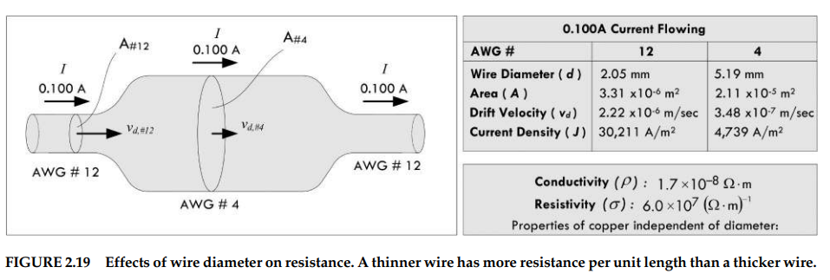

Slide 32

Resistivity and Conductivity
We have left out the most important aspect of resistance that has nothing to do with the physical length or diameter of the material
How does the “chemistry” of the material affect the resistance?
For example, if you have a copper wire with the same dimensions as a brass wire, which metal has the greater overall resistance?
To answer this question, as well as provide a way to categorize materials, we adopt the concept of resistivity
Unlike resistance, resistivity is entirely independent of the dimensions of the material
Resistivity is a property unique to the material. The resistivity ρ is defined as follows:

Slide 33

Where A is the cross- sectional area, L is the length, and R is the overall resistance of the material, as measured across its length
The units of resistivity are ohm-meters (Ωm)
For some, resistivity is too negative a concept—it tells you how “bad” something is at passing current
Optimists prefer the concept of conductivity—how “good” something is at passing current.
Conductivity, symbolized σ, is simply the mathematical inverse of resistivity:

Slide 34

The units of conductivity are siemens, S = (Ωm)⁻¹. (Mathematical note: [Ωm]⁻¹ = 1/[Ωm])
Both conductivity and resistivity contain the same important underlining information
In terms of resistivity and conductivity, we can rewrite Ohm’s law as follows:

Slide 35
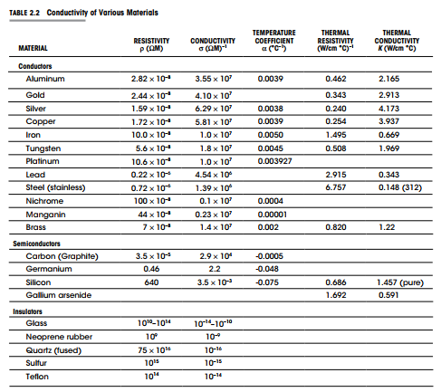

Slide 36
Insulators, Conductors, and Semiconductors
As we have seen, the electrical resistivities of materials vary greatly between conductors and insulators.
A decent conductor has around 10⁻⁸ Ωm; a good insulator has around 10¹⁴ Ωm; a typical semiconductor from 10⁻⁵ to 10³ Ωm—depending on temperature.

Slide 37

Heat and Power
We discovered the generalized power law, which tells us that if we can measure the current entering a device, as well as the voltage across the device, we know the power that is used by the device:
The generalized power law tells us how much power is pumped into a circuit but doesn’t say anything about how this power is used up

Slide 38
Let’s consider a two-lead black box—an unknown circuit that may contain all sorts of devices, such as resistors, lamps, motors, or transistors.
If all we can do is measure the current entering the black box and the voltage across it—say, using an ammeter and voltmeter (or singularly, a wattmeter)—we could apply the generalized power law, multiply the measured current and voltage readings together, and find the power pumped into the black box
For example, in Fig. 2.22, we measure 0.1 A entering when a voltage of 10 V is applied, giving us a total consumed power of 1 W.

Slide 39
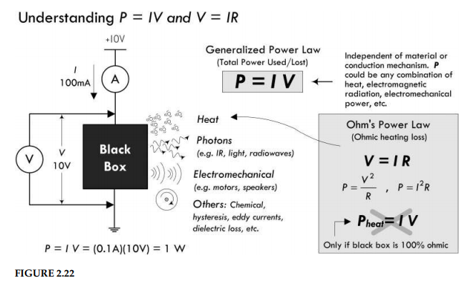

Slide 40
Knowing how much power is pumped into the black box is incredibly useful— it allows for quick power consumption measurements and often simplifies circuit analysis—as we’ll see later.
But let’s say that we are interested in figuring out how much power is lost to heating (energy that goes into lattice vibrations, emissive radiation, etc.).
We really can’t say, assuming we aren’t allowed to look inside the black box.
There could be devices inside that take some of the initial energy and use it to do useful work, such as generating magnetic fields in the armature (rotor) and stator sections of a motor, causing the stator to rotate; or generating a magnetic field in a voice coil attached to a paper speaker cone that compresses air; or generating light energy, radio waves, and so on.
There may be power converted into other weird forms not really coined as heat, such as driving chemical reactions, generating hysteresis effects, or eddy current in transformers.

Slide 41
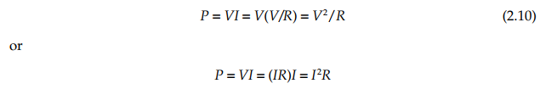
The only time we can say for certain that power is totally converted into heat energy is if we assume our black box is a perfect resistor (100 percent ohmic in nature).
Only then can we substitute Ohm’s law into the generalized power equation:

Slide 42

In this form, the power lost due to heating is often called Ohmic heating, Joule heating, or I²R loss.
Be careful how you interpret this law
For example, let’s consider our black box that drew 1 W of power
Given the power and the current—which we measure— it would be easy to assume that the resistance of the black box is:

Slide 43
Accordingly, we would say the black box is a 100-Ω resistor generating 1 W of heat.
As you can see, this is an erroneous assumption, since we have disregarded the internal workings of the black box—we didn’t account for devices that perform useful work.
You’ll often see people treat any load (black box) as a resistor when doing circuit analysis and such.
This will get you the right answer when solving for a particular variable, but it is an analysis trick and shouldn’t be used to determine how much heat is being generated, unless, of course, the black box is actually a resistor
The following example provides some insight into where power is being used and how much of it is being converted into heat

Slide 44
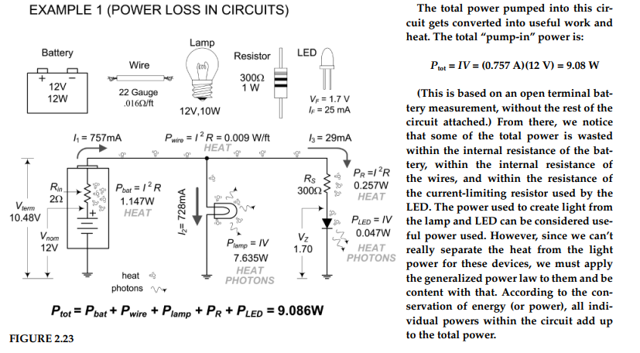

Slide 45
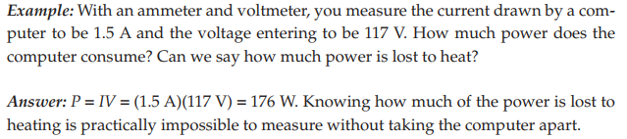
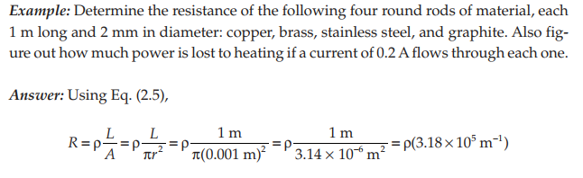

Slide 46
